Slide 1
Enron 2.0: Predicting California's Energy Consumption
John Muhs and Corbett Carrel

Slide 2
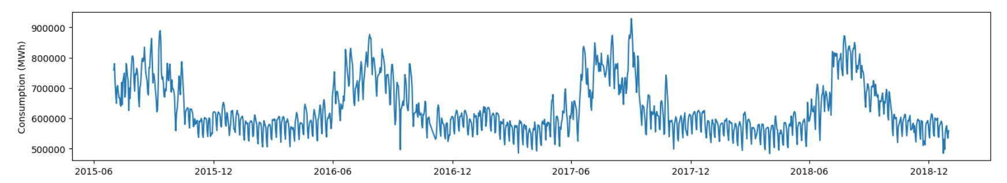
California Energy Consumption
Indicators?
Weather
Economic Data
Population
Other Factors

Slide 3
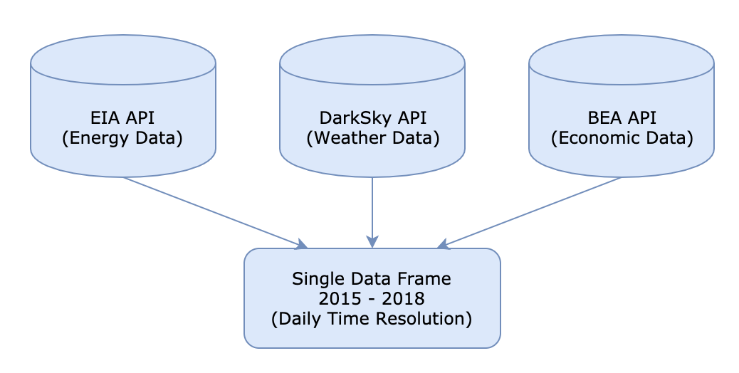
Data Sources
isWeekend
Month Integer
Day of Year
California Power Customer Count
Gross Domestic Product
California Population
Temperature Values
Dew Point
Precipitation
Other Weather Parameters

Slide 4
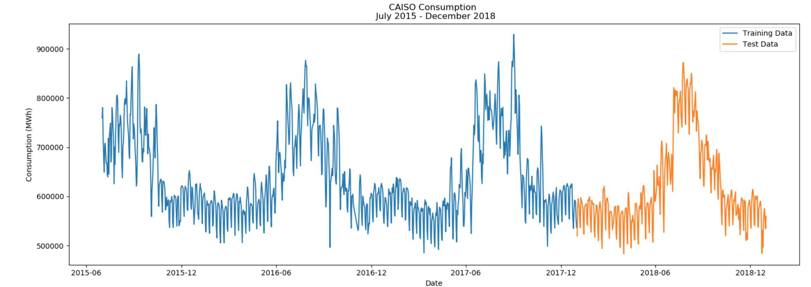
CASIO Test Split

Slide 5
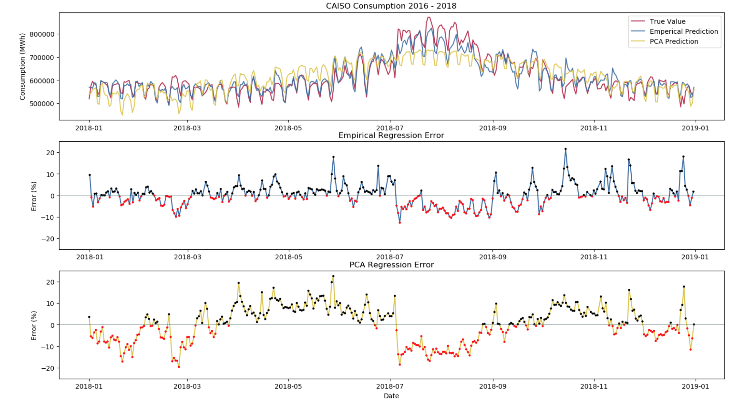
Predictions from Linear Regression

Slide 6
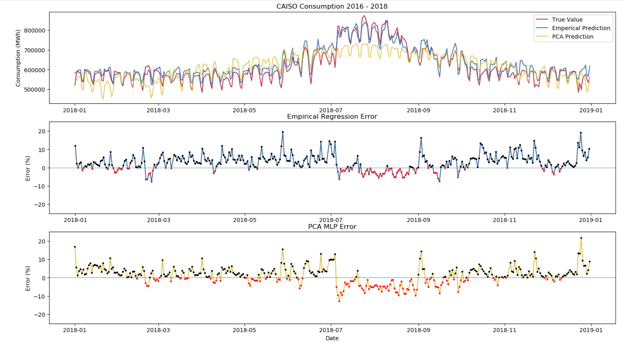
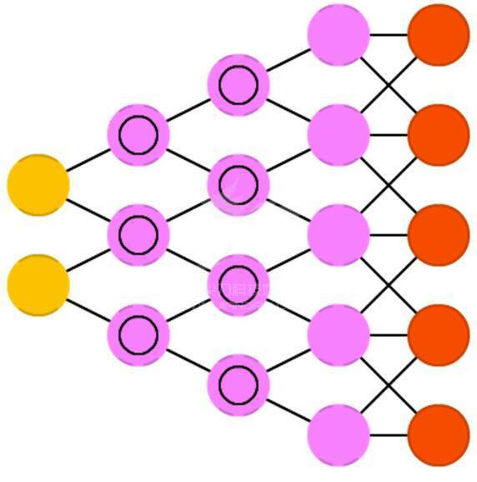
Predictions from Multi-layer Perceptron Regression

Slide 7
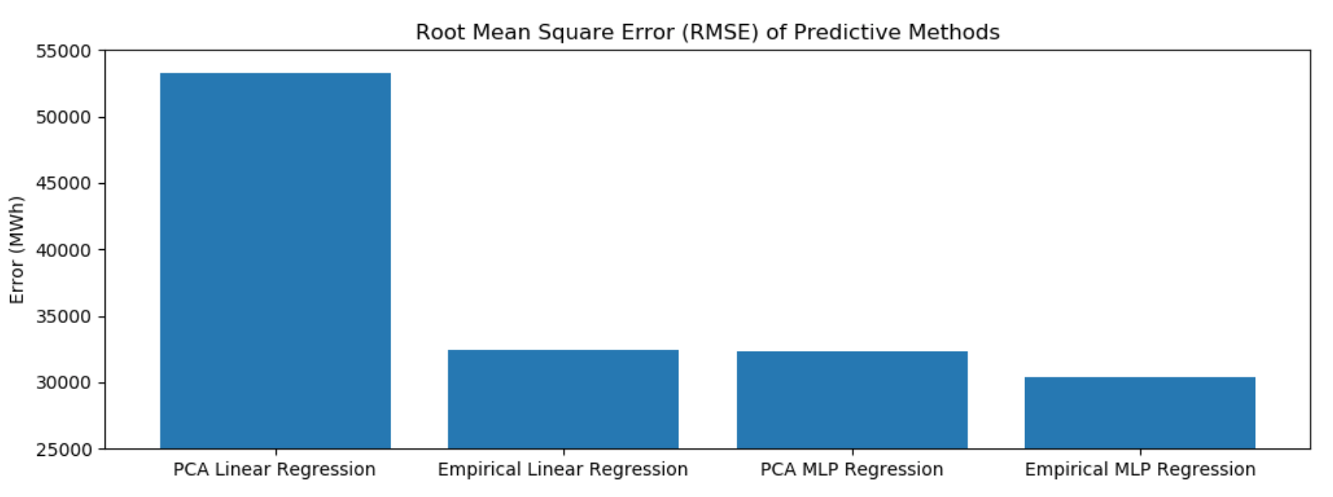
Error Comparison

Slide 8


Thank you

Slide 9
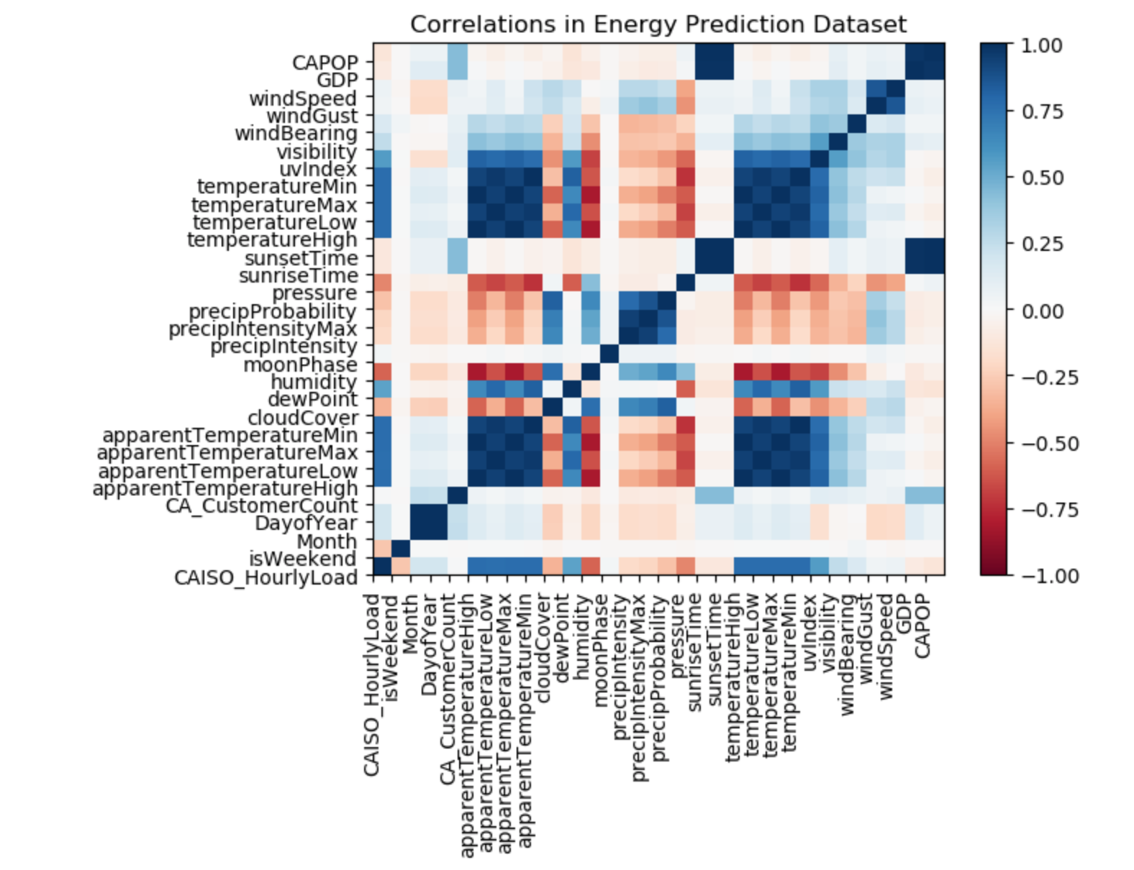
Dimension Reduction
Redundant Variables
Low Correlation Variables
Statistical Significance
Reduced dimensions from 30 variables to 8 variables

Slide 10
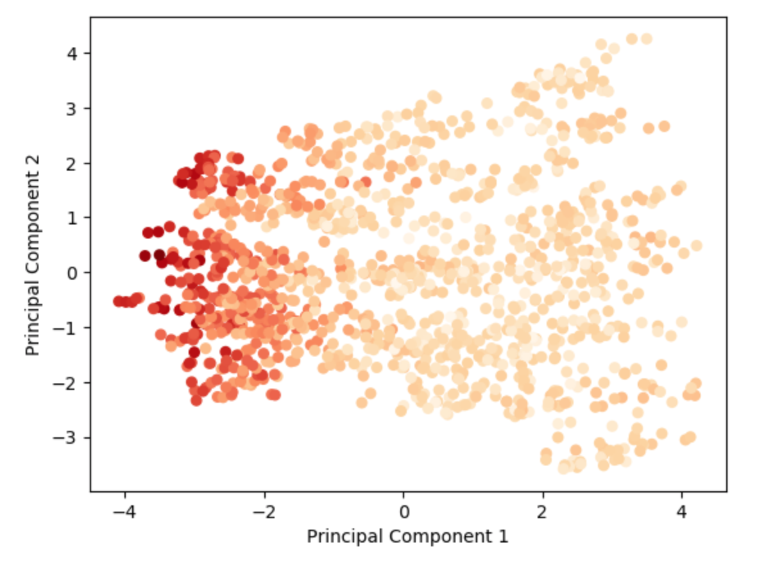
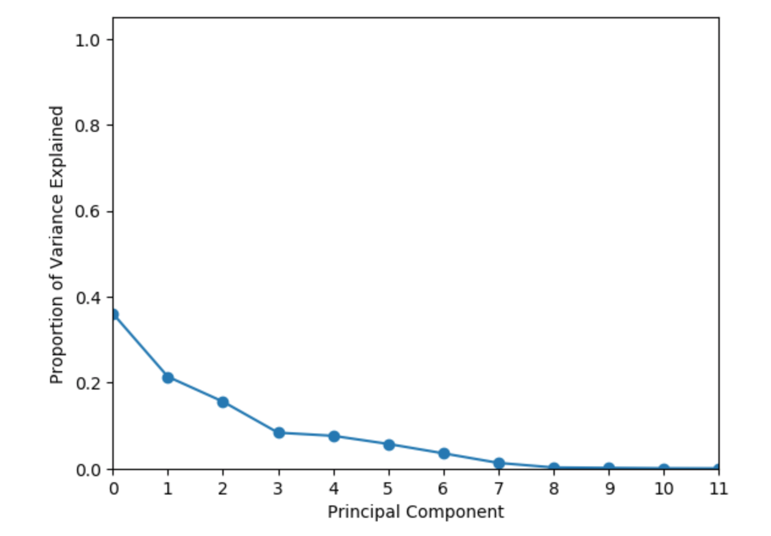
Principal Component Analysis

